Slide 1
Problem identification (1-2 slides)
Recommendation and key findings (1 slide)
Modeling results and analysis (3-4 slides)
Summary and conclusion (1 slide)

Slide 2
Recommendations for Big Mountain Resort
Maryam Nozari

Slide 3
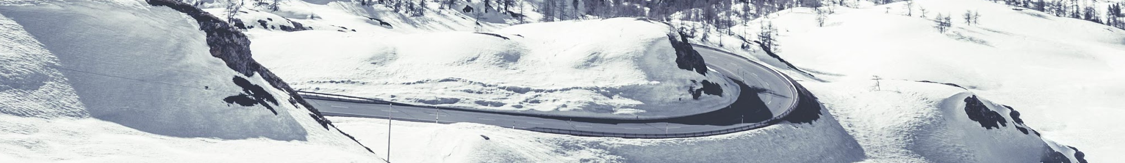
What opportunities exist for Big Mountain Resort to reduce annual operation costs by $1.5 M by capitalizing on its facilities, selecting a better value for its ticket price, or making operational improvements?
Assumption: All resorts are largely setting prices based on how much people value certain facilities and prices are set by a free market.

Slide 4
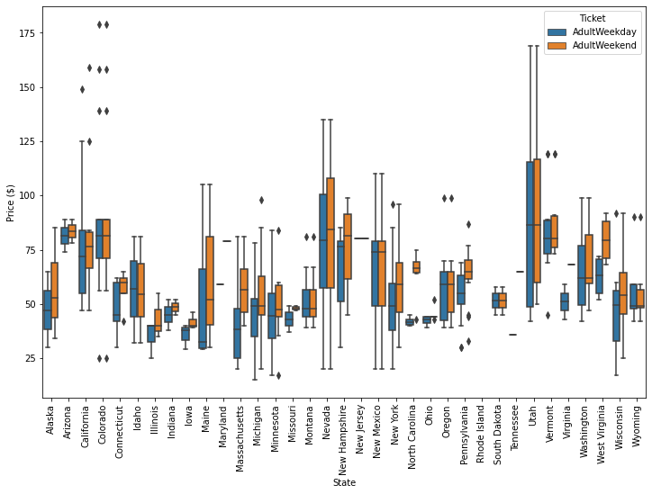
Distribution Of Ticket Price By State
The figure represents a data frame with two columns, one for the average prices of each kind of ticket. This shows how the average ticket price varies from state to state.

Slide 5
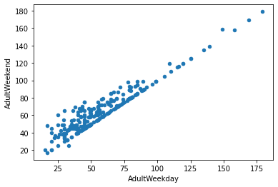
Notes:
A couple of observations can be made. Firstly, there is a clear line where weekend and weekday prices are equal. Weekend prices being higher than weekday prices seem restricted to sub $100 resorts. Recall from the boxplot earlier that the distribution for weekday and weekend prices in Montana seemed equal. Is this confirmed in the actual data for each resort? Big Mountain resort is in Montana, so the relationship between these quantities in this state are particularly relevant.
Weekend prices have the least missing values of the two, so drop the weekday prices and then keep just the rows that have weekend price.

Slide 6
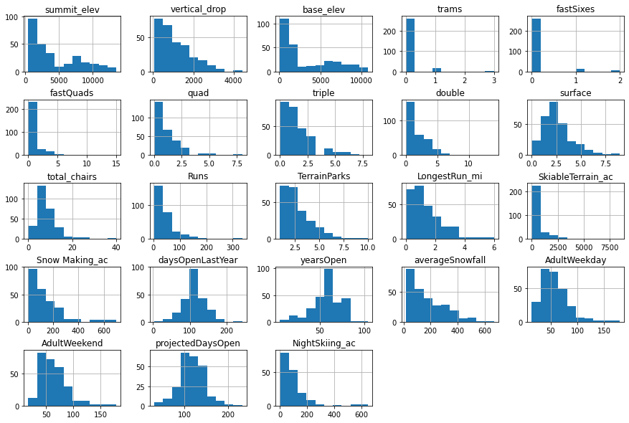
Features Distribution
There are some skewed distributions:
fastQuads, fastSixes, and perhaps trams.
These lack much variance away from 0 and may have a small number of relatively extreme values. Models failing to rate a feature as important when domain knowledge tells you it should be is an issue to look out for, as is a model being overly influenced by some extreme values.
If you build a good machine learning pipeline, hopefully it will be robust to such issues, but you may also wish to consider nonlinear transformations of features.

Slide 7
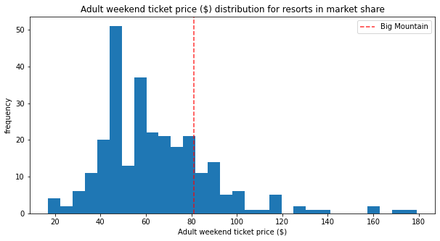

Slide 8
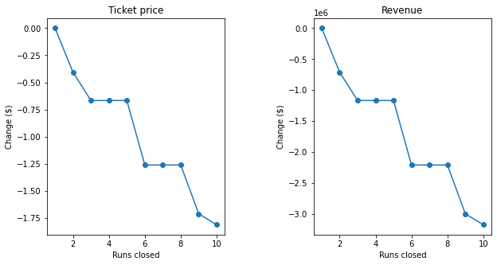
Close up to 10 of the least used runs
Closing 2 and 3 run reduces support for ticket price and so revenue. If Big Mountain closes down 3 runs, it seems they may as well close down 4 or 5 as there's no further loss in ticket price. Increasing the closures down to 6 or more leads to a large drop.

Slide 9
Recommendation
Permanently closing down up to 10 of the least used runs. This doesn't impact any other resort statistics.
Increase the vertical drop by adding a run to a point 150 feet lower down but requiring the installation of an additional chair lift to bring skiers back up, without additional snow making coverage
Same as number 2, but adding 2 acres of snow making cover
Increase the longest run by 0.2 mile to boast 3.5 miles length, requiring an additional snow making coverage of 4 acres

Slide 10
Senario 2: In this scenario, Big Mountain is adding a run, increasing the vertical drop by 150 feet, and installing an additional chair lift.
This scenario increases support for ticket price by $8.61
Over the season, this could be expected to amount to $15065471

Slide 11
Scenario 3: Scenario 2+ adding 2 acres of snow making.
This scenario increases support for ticket price by $9.90
Over the season, this could be expected to amount to $17322717

